Slide 1


Bangladesh Army University of Engineering & Technology
Department of Computer Science and Engineering
EEE 2261: Electrical Drives and Instrumentation
Winter 2025 Semester
Lecture-01
Course Teacher
S. M. Ashik Al Mashrafi
Lecturer, EEE, BAUET
Total Credit: 3.0 Credit Taking: 3.0

Slide 2

Course Content
Chapter | Topics
Introduction | Three phase circuits, alternators and transformers, principles & operation of DC Machines, synchronous, induction, universal and stepper motors, thyristor and microprocessor-based speed control of motors
Instrumentation Amplifiers | Differential, logarithmic, and chopper amplifiers, frequency and voltage measurements using digital techniques, recorders and display devices, spectrum analyzers and logic analyzers, data acquisition and interfacing to microprocessor-based systems;
Transducers | Terminology, types of transducers, principles and applications of photovoltaic, piezoelectric, thermoelectric, variable resistance and opto-electronics transducers. Noise reduction in instrumentation

Slide 3
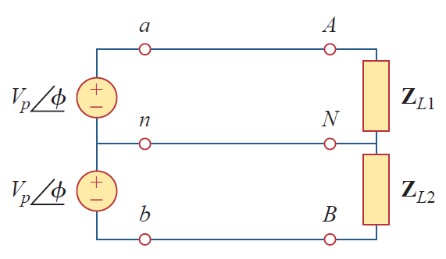
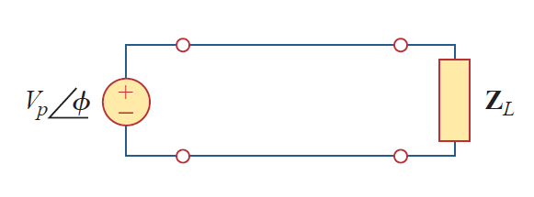
Single Phase System
Fig. 1: Single phase two wire system
Fig. 2: Single phase three wire system

Slide 4
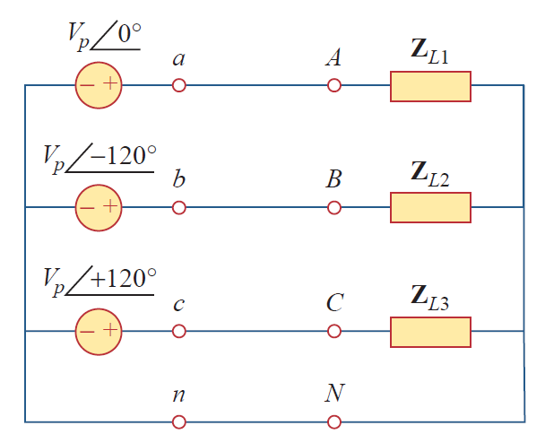
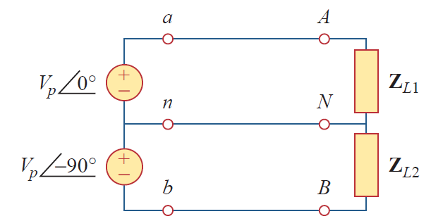
Polyphase System
Fig. 3: Two phase three wire system
Fig. 4: Three phase four wire system

Slide 5
Polyphase System
Circuits or systems in which the ac sources operate at the same frequency but different phases are known as polyphase.
Fig. 4: Three phase four wire system

Slide 6
Polyphase System
A two-phase system is produced by a generator consisting of two coils placed perpendicular to each other so that the voltage generated by one lags the other by 90°
By the same token, a three-phase system is produced by a generator consisting of three sources having the same amplitude and frequency but out of phase with each other by 120°
Fig. 5: Three phase generator

Slide 7
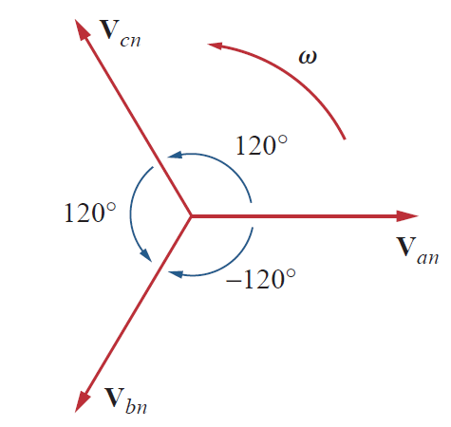
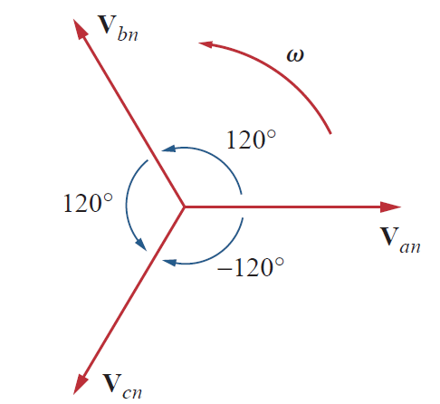
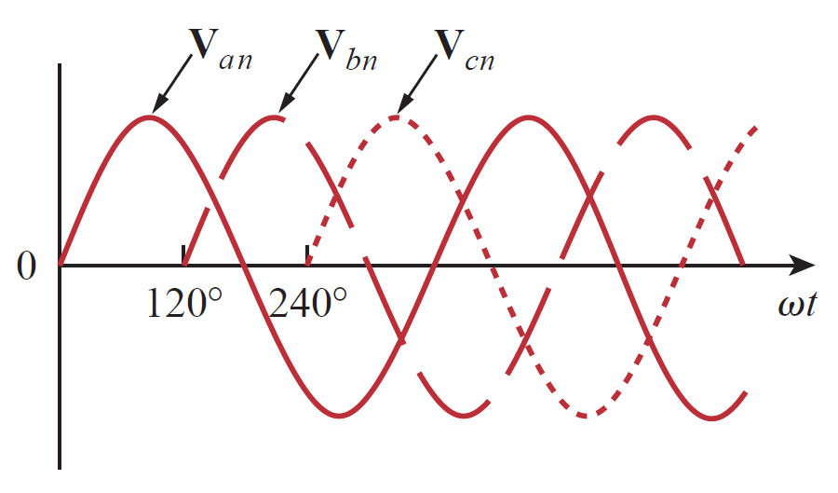
Balanced Three Phase System
Fig. 6: Three phase signal
Fig. 7: Phasor diagram (abc sequence / positive sequence)
Fig. 8: Phasor diagram (acb sequence / negative sequence)

Slide 8
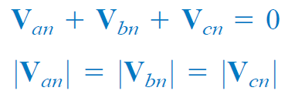
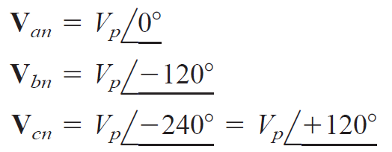
Balanced Three Phase System
Fig. 6: Three phase signal
Fig. 7: Phasor diagram (abc sequence / positive sequence)

Slide 9
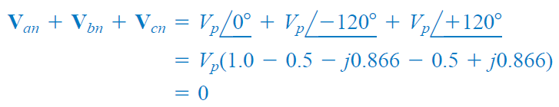
Balanced Three Phase System

Slide 10
Thank You
For Your Attention

